Slide 1

MODULE 2: THE PEER SUPPORT RELATIONSHIP
Exploring values, relationships, boundaries and risks.
MODULE 2 SESSION 2
IDENTIFY PERSONAL COMMUNICATION AND BEHAVIOUR PATTERNS AND THEIR IMPACT

Slide 2

MODULE 2: THE PEER SUPPORT RELATIONSHIP
Exploring values, relationships, boundaries and risks
Learning Intentions
Agree core behaviours that produce an empowering and safe learning environment.
Define how your personal values relate to the ‘HEAR ME’ values used in peer support.
Examine personal communication preferences reflecting on the impact on self and others, specifically when providing peer support.
Connect values and communication to peer support language and behaviours.

Slide 3
MODULE 2: THE PEER SUPPORT RELATIONSHIP
Exploring values, relationships, boundaries and risks
Empowering and Safe Learning Environment
Connection
Device free environment, maintaining confidentiality.
Hope and optimism
Focussing on the possible.
Identity
Listening with grace and attention to the stories of others.
Meaning
Deep respect for difference, no voices of judgement or cynicism.
Empowerment
Generating fun ideas, engaging with new thinking making personal commitments to change.

Slide 4
MODULE 2: THE PEER SUPPORT RELATIONSHIP
Exploring values, relationships, boundaries and risks
HEAR ME VALUES
HOPE
We believe in the reality of recovery for all.
EXPERIENCE
We believe recovery is a unique and individual experience.
AUTHENTICITY
We believe being authentic is about being true to ourselves.
RESPONSIBILITY
We believe wellness and recovery involves taking responsibility.
MUTUALITY
We believe that mutuality is core to peer working.
EMPOWERMENT
We believe empowerment means being in the driving seat.

Slide 5
MODULE 2: THE PEER SUPPORT RELATIONSHIP
Exploring values, relationships, boundaries and risks
Checking In Question
How do your personal values relate to the HEAR ME values used in peer support?

Slide 6
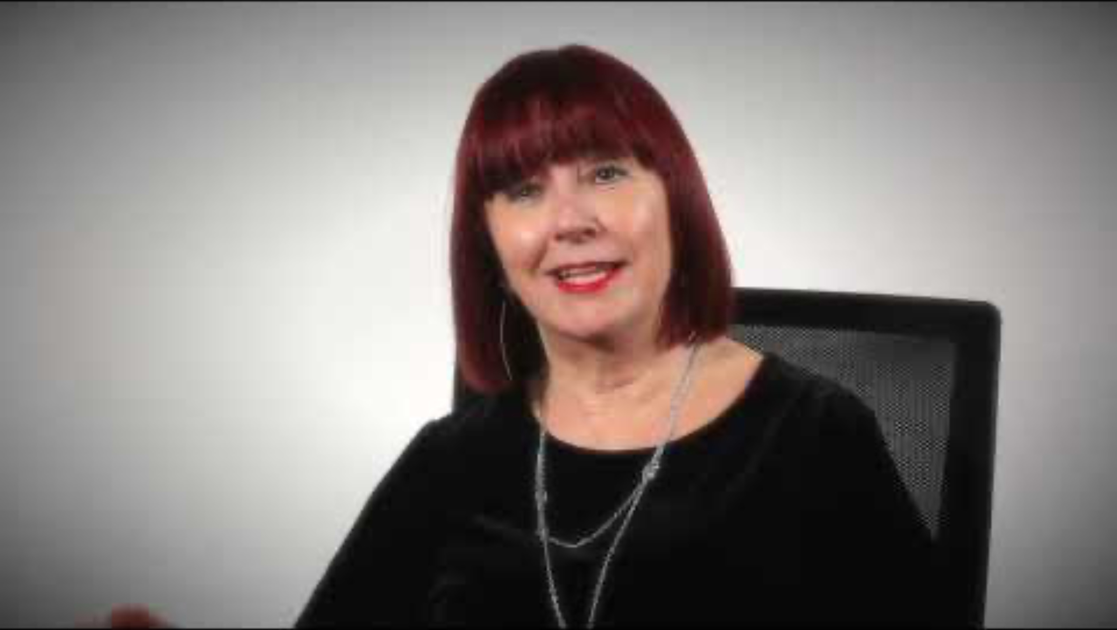
MODULE 2: THE PEER SUPPORT RELATIONSHIP
Exploring values, relationships, boundaries and risks

Slide 7

MODULE 1: INTRODUCING PEER SUPPORT: Understanding recovery and peer support.
Pairs Conversation
Reflect on the video and take 20 minutes in your pairs to share the thinking that you recorded on the workbook pages 13-15.
Why does this matter in peer support roles?
Make some additional notes as you go.

Slide 8
MODULE 2: THE PEER SUPPORT RELATIONSHIP
Exploring values, relationships, boundaries and risks
Checking Out Question
What has been significant about your learning experience with us today?

