Slide 1
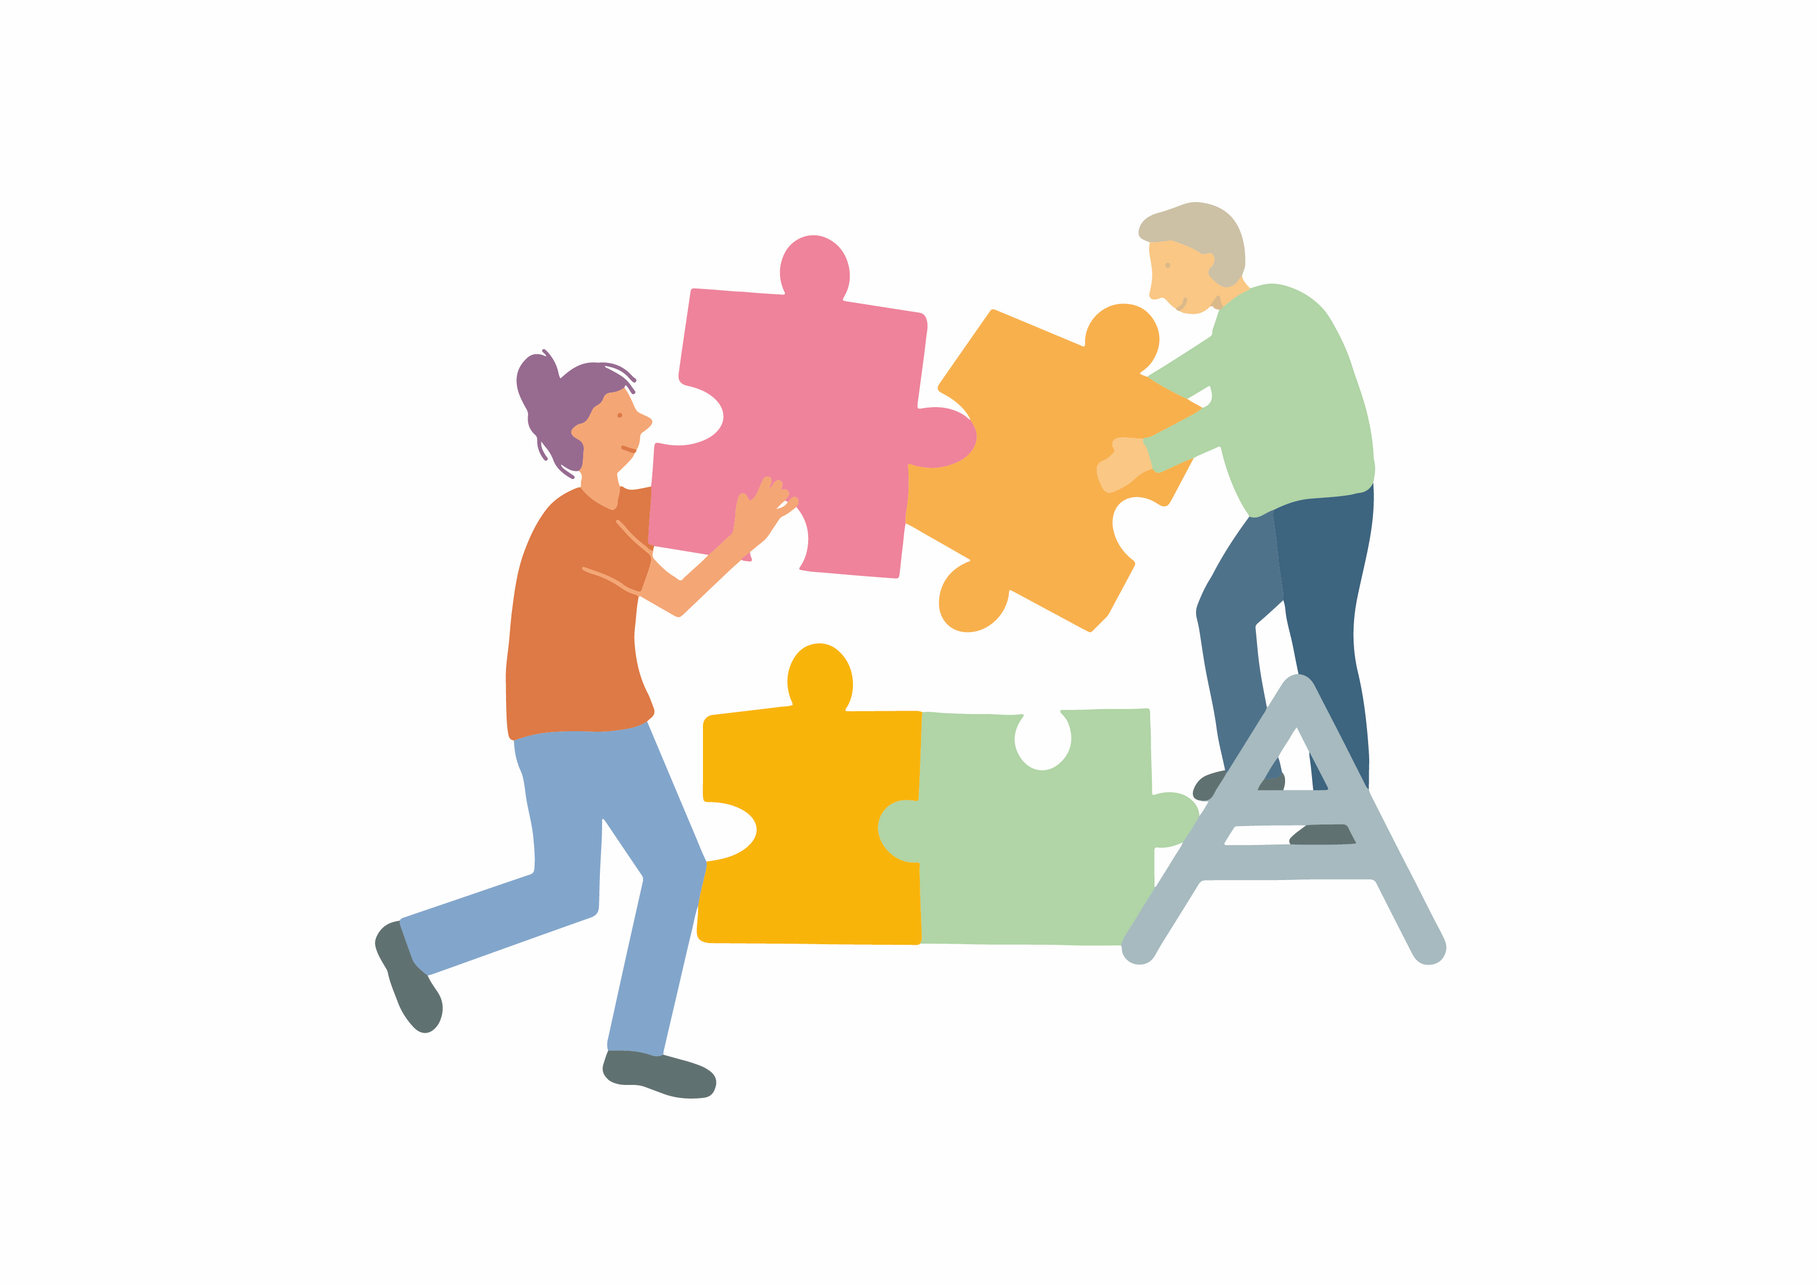
MODULE 1: INTRODUCING PEER SUPPORT: Understanding recovery and peer support.
MODULE 1 SESSION 3
ENGAGE WITH PERSONAL VALUES AND BEHAVIOURS

Slide 2
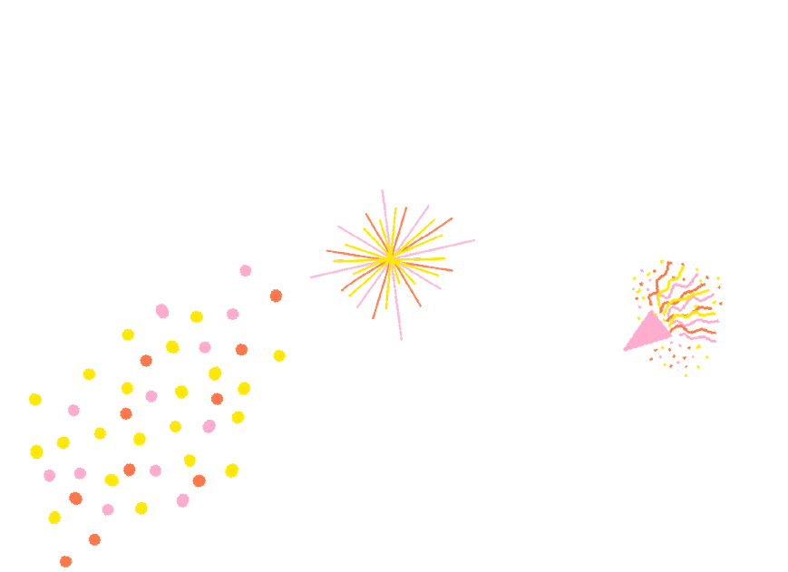
MODULE 1: INTRODUCING PEER SUPPORT: Understanding recovery and peer support.
Learning Intentions
Agree core behaviours that produce an empowering and safe learning environment.
Introduce the CHIME (Connectedness, Hope, Identity, Meaning and Empowerment) model and the connection to personal values and behaviours.
Connect values and communication to maintaining empowerment on the peer support journey.

Slide 3
MODULE 1: INTRODUCING PEER SUPPORT: Understanding recovery and peer support.
Empowering and Safe Learning Environment
Connection
Device free environment, maintaining confidentiality.
Hope and optimism
Focussing on the possible.
Identity
Listening with grace and attention to the stories of others.
Meaning
Deep respect for difference, no voices of judgement or cynicism.
Empowerment
Generating fun ideas, engaging with new thinking making personal commitments to change.

Slide 4
MODULE 1: INTRODUCING PEER SUPPORT: Understanding recovery and peer support.
Checking In Question
What did you learn from the pre-work about values and behaviours?

Slide 5
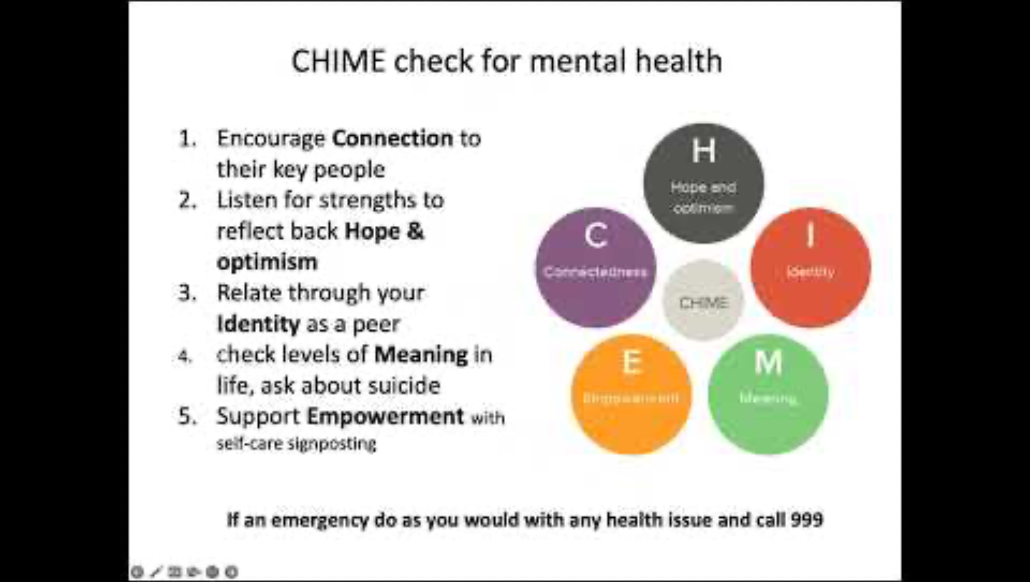
MODULE 1: INTRODUCING PEER SUPPORT: Understanding recovery and peer support.
CHIME at MORAY WELLBEING HUB

Slide 6
MODULE 1: INTRODUCING PEER SUPPORT: Understanding recovery and peer support.
Pairs Conversation
Take 20 minutes in your pairs to share the thinking that you recorded on the workbook pages 13-17.
Make some additional notes as you go.

Slide 7
Values and beliefs, inform our attitude.
Values and beliefs start in our family of origin. This is the first ‘system’ that we belong to. This includes; social context, education, religion and ethnicity.
These messages about good/bad, right and wrong, ok and not ok form the lens through which we view the world.
We accept, discard and respond to these messages based on how they ‘make us feel’, and as we grow and learn from our own experience.
We see our attitude in our behaviour.
ATTITUDE CYCLE
MY ATTITUDE
MY BEHAVIOUR
YOUR ATTITUTE
YOUR BEHAVIOUR
Choice moment, I can
decide my behaviour.

Slide 8
TRANSACTIONAL ANALYSIS
The Parent Ego State
LIFE AS IT WAS TAUGHT
CONTROLLING PARENT Rules/Boundaries
NURTURING PARENT
Care/Support
The Child Ego State
LIFE AS IT WAS FELT
REBELLIOUS
ADAPTED CHILD
Defiant/Selfish
COMPLIANT
ADAPTED CHILD
Obedient/Anxious
NATURAL CHILD
Freedom and Curiosity
The Adult Ego State
LIFE AS IT WAS EXPERIENCED
ADULT
Logical/Fair/Calm

Slide 9
MODULE 1: INTRODUCING PEER SUPPORT: Understanding recovery and peer support.
Checking Out Question
What has been significant about your learning experience with us today?

