Slide 1

MODULE 1: INTRODUCING PEER SUPPORT: Understanding recovery and peer support.
MODULE 1 SESSION 1
CO-CREATE AN EMPOWERING AND SAFE LEARNING ENVIRONMENT

Slide 2

MODULE 1: INTRODUCING PEER SUPPORT: Understanding recovery and peer support.
Learning Intentions
Define and agree the key components of an empowering and safe learning environment.
Come together as a learning group, sharing who you are and what matters to you.
Commit to a code of behaviour for the group.

Slide 3
MODULE 1: INTRODUCING PEER SUPPORT: Understanding recovery and peer support.
Empowering and Safe Learning Environment
Connection
Device free environment, maintaining confidentiality.
Hope and optimism
Focussing on the possible.
Identity
Listening with grace and attention to the stories of others.
Meaning
Deep respect for difference, no voices of judgement or cynicism.
Empowerment
Generating fun ideas, engaging with new thinking making personal commitments to change.

Slide 4
MODULE 1: INTRODUCING PEER SUPPORT: Understanding recovery and peer support.
Checking In Question
Say your name and what matters to you about undertaking this Peer 2 Peer Programme.

Slide 5

MODULE 1: INTRODUCING PEER SUPPORT: Understanding recovery and peer support.

Slide 6
MODULE 1: INTRODUCING PEER SUPPORT: Understanding recovery and peer support.
Reflecting on Pre-Work
You were invited to complete pages 4-6 in the workbook before you came.
Take 15 minutes in pairs to share your responses to the questions.
What would you like to share with the wider group?

Slide 7
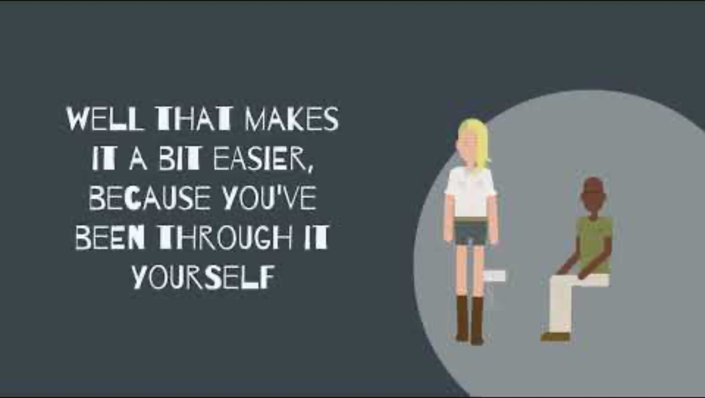
MODULE 1: INTRODUCING PEER SUPPORT: Understanding recovery and peer support.

Slide 8
MODULE 1: INTRODUCING PEER SUPPORT: Understanding recovery and peer support.
2 minutes to think about the following question:
How does Hollie’s story inspire you around your peer support journey?

Slide 9
MODULE 1: INTRODUCING PEER SUPPORT: Understanding recovery and peer support.
Checking Out Question
What has been significant and surprising about your learning with us today?

