Slide 1
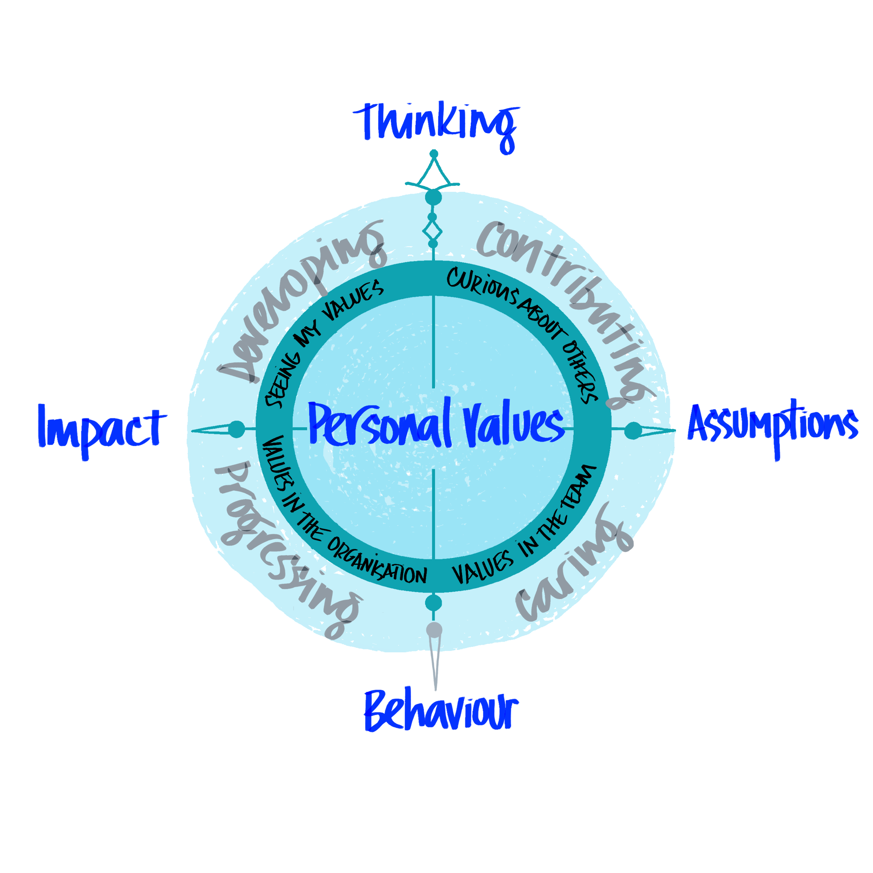
Welcome
A conversation about values driven behaviour

Slide 2

Co-creating Organisational Values: The Process
A values toolbox was developed to explain the organisations values refresh.
Everyone was invited to complete a Personal Values Audit as part of working through this toolbox.
As of 30 June, 815 people had uploaded their values, enabling an overall, and individual team picture to emerge.
The overall picture included ‘basic needs values’ such as financial and health; for the purpose of creating organisational values/ team values these were removed. You can see both side by side in the accumulator.
A set of Universal Behaviours were developed to enable everyone to see what is expected and how they can demonstrate the values.
On 10 July, the Values Statement and the associated Universal Behaviours were signed off by the Executive Leadership Team.

Slide 3
Individual/Team/Organisation Values: How does it fit?
The 3 Organisation Values are the guiding values for the future of the organisation these will be woven through all people processes and will form the basis of all development and performance conversations, alongside the Universal Behaviours which define what everyone needs to do in a consistent way to meet the values.
The toolbox remains open for people to upload their values and see the emerging team picture. This team picture can be used to explore how the team values profile will deliver the 3 Organisational Values and the Universal Behaviours.
There will be corporate launch and comms around all of this, but for now we wanted to explain the thinking and get started with the conversations.

Slide 4
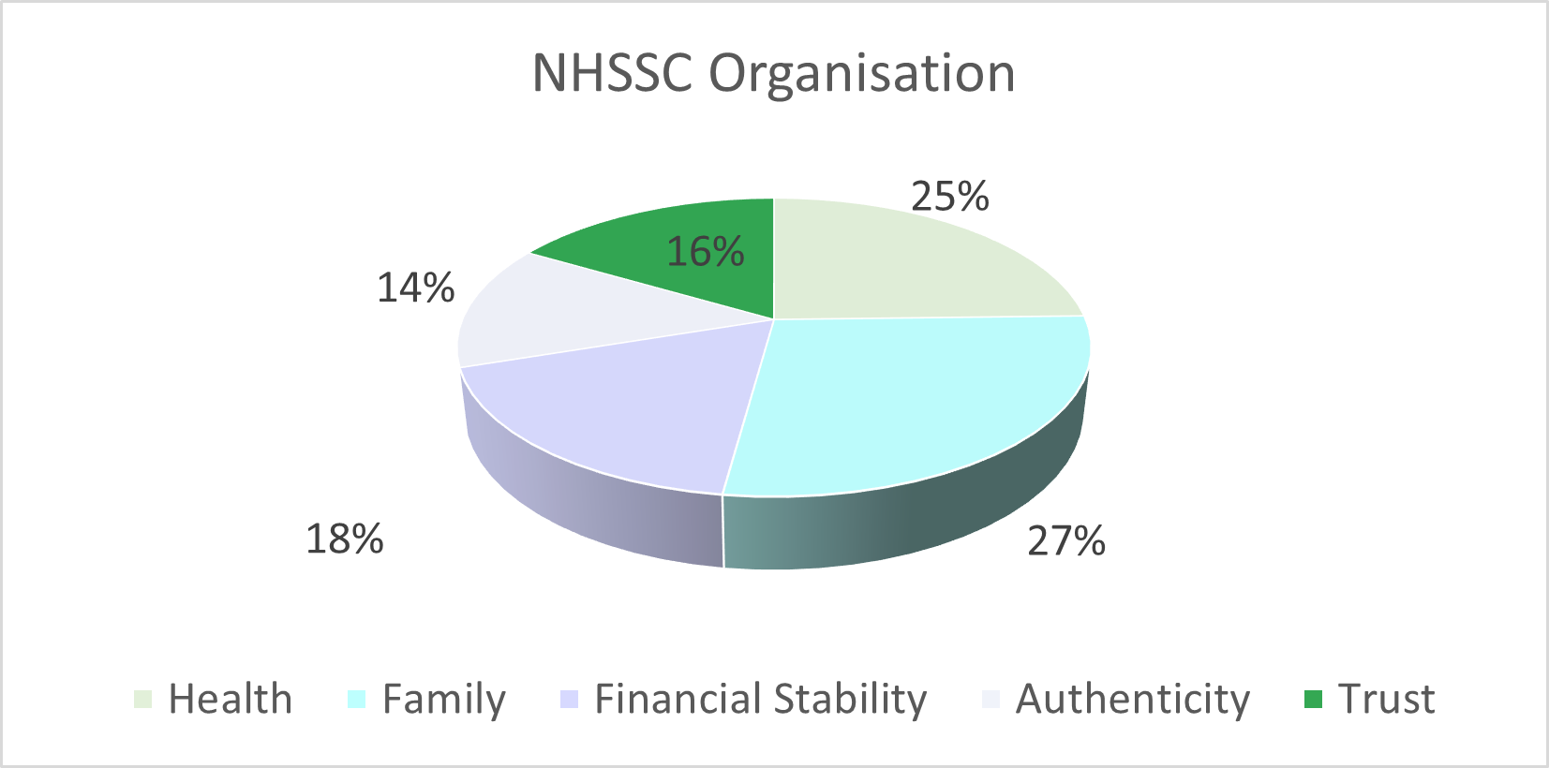
The Results : With ‘basic needs’

Slide 5
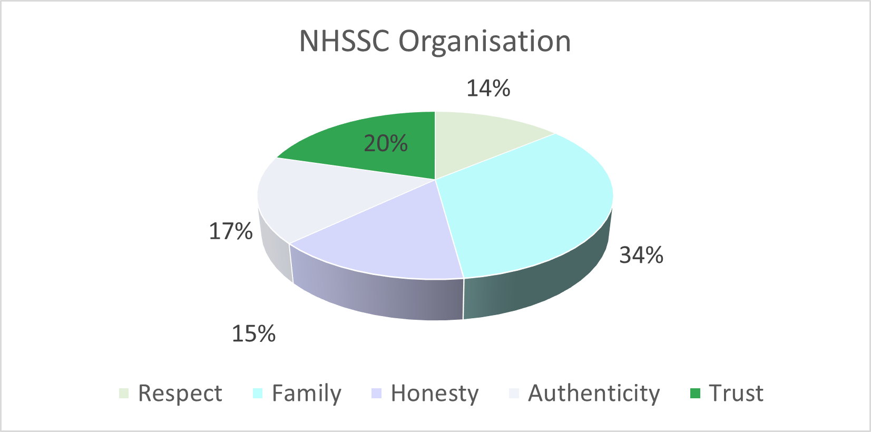
The Results : Without ‘basic needs’

Slide 6
The Final Values Statements
OUR VISION
To make it easier for the NHS to put patients first.
OUR PURPOSE
To help the NHS to save lives and improve health.
OUR VALUES: GUIDING OUR FUTURE
Trust: I treat others with respect and trust them to do their best for the organisation.
Community: I belong to something bigger; I am accountable for my contribution across the organisation.
Authenticity: I am honest, clear and kind in all my interactions and communication with others.

Slide 7
The Universal Behaviours
Each of the behaviours statements is designed to apply to everyone irrespective of grade or place in the organisation: shaping equity.
The behaviour statements are aligned to research around factors and behaviours that grow motivation, trust and communities of practice: feeding the values.
The behaviour statements will be supported by development conversations for every person in the business and are aligned to Leadership Development: creating consistency.
The behaviours statements define the ‘how’ everyone is expected to behave providing a framework for feedback and growth: defining a safe and productive working environment.

Slide 8
The Universal Behaviours
OUR UNIVERSAL BEHAVIOURS: CO-CREATING OUR FUTURE
I demonstrate respect for the thinking and intentions of others, providing and asking for feedback.
I play to my strengths and encourage others to do so, to deliver excellence.
I take responsibility for my wellbeing and contribute to the wellbeing of others.
I am accountable for my contribution and jointly responsible for my team’s performance.
I am responsible for my communication and the impact I have.
I use my voice positively to share ideas, thoughts and concerns, contributing to transparency in my team and wider relationships.

