Slide 1
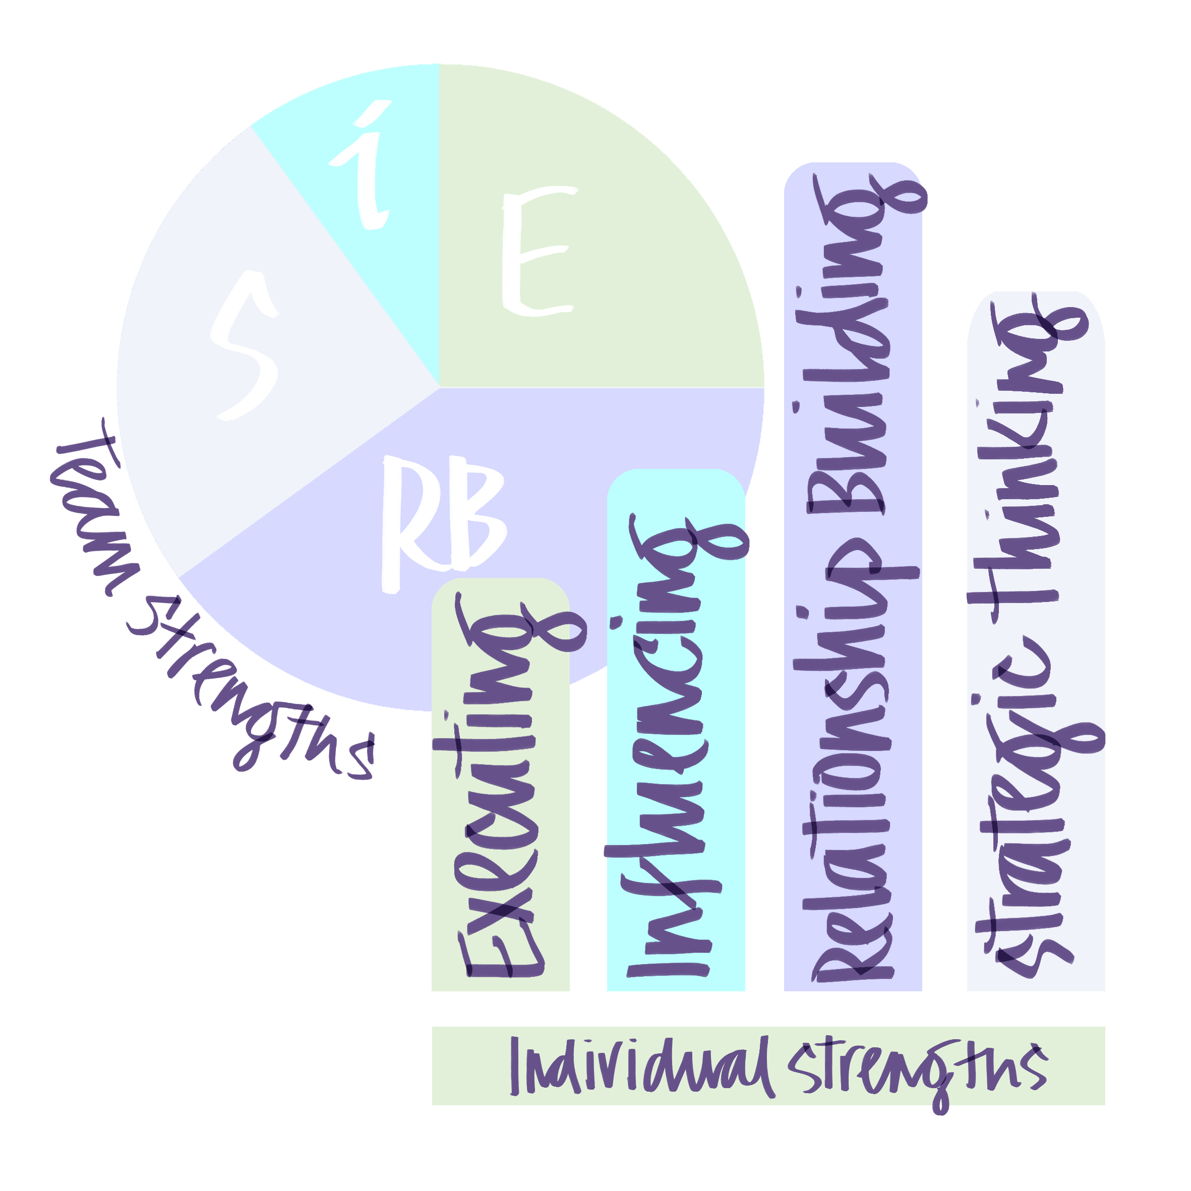
Team Strengths Session

Slide 2
Rules of Engagement
One voice at a time, no interrupting. Everyone is expected to contribute and will have equal space to do so.
Listening with attention, grace and ease, no devices (avoid using chat or yellow hand).
Curious and non-judgemental; Thinking Equals.
Challenge and support.
Awareness of assumptions.
Agreeing next steps.
Appreciation.

Slide 3
Learning Intentions
Reflect on the impact of completing the strengths assessment.
Introduce the team strengths profile.
Explore how you see the team strengths working for us and against us in terms of the 4 strengths domains.
Describe next steps.

Slide 4
Checking In- reflecting on prework
You we asked to review the material in the Accumulator part of the toolbox for your team.
Take 2 minutes to record what felt surprising to you.
Next, we will hear from everyone without interruption.

Slide 6
Community of Strengths
Each group has a domain, locate the analysis for this domain on the toolbox, by going to https://laa.fionamacneill.com/the-accumulator/ and choosing your team from the drop down.
Where and how do you see these strengths making a difference to performance and relationships – please provide specific examples?
Where and how do you see the shadow side of these strengths making a difference to performance and relationships – please provide specific examples?
40 minutes be pre-pared to feedback 2 learning points to each question.

