Slide 1
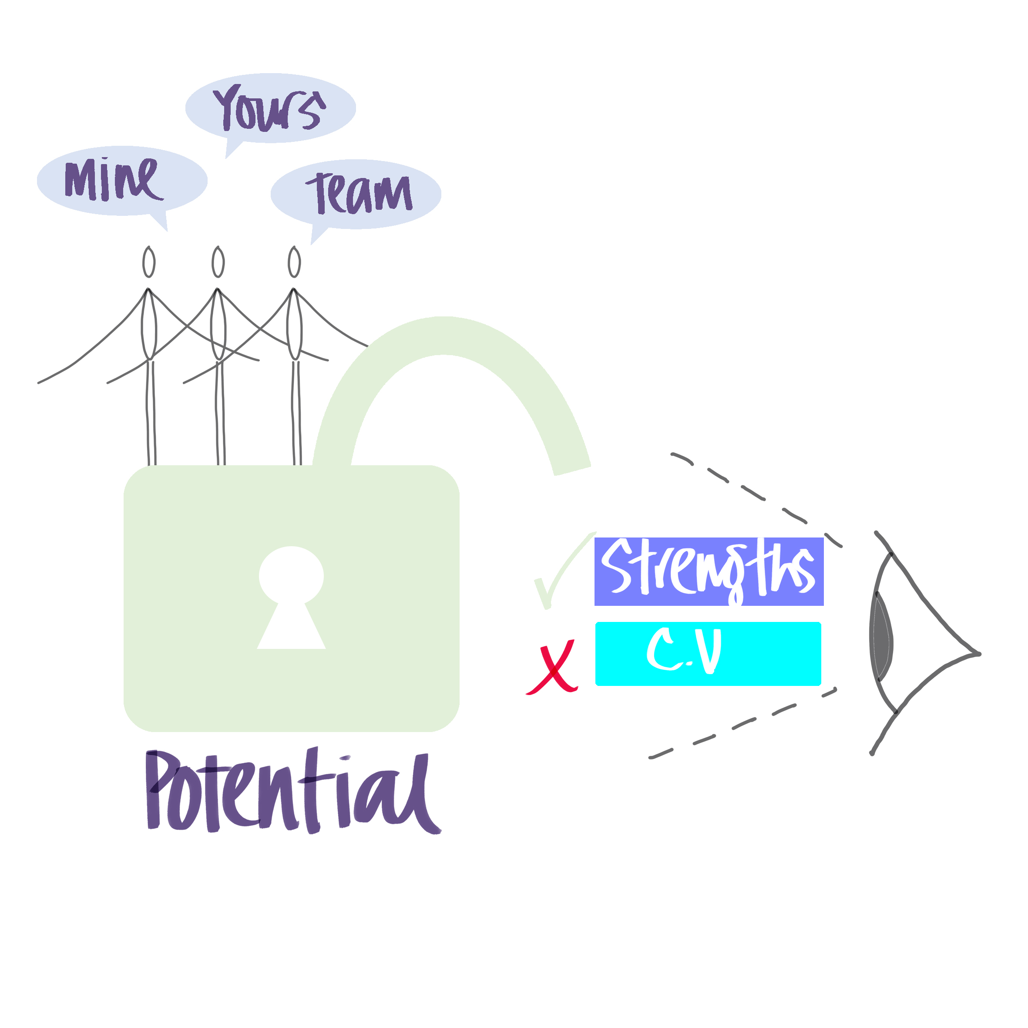
INTRODUCING STRENGTHS BASED TEAMS

Slide 2
RULES OF ENGAGEMENT
One voice at a time, no interrupting - note questions as we go.
Listening with attention, grace and ease
(no other devices, camera on/ mike off, please don’t use the chat or yellow hand).
Curious and non-judgemental; Thinking Equals.
Challenge and support.
Awareness of assumptions.
Learn from the process as well as the content.
Appreciation.

Slide 3
LEARNING INTENTIONS
Introduce the concept of Strengths Based Teams.
Reflect on the impact of the pre-work.
Identify how it fits with the LAA Way.
Define the next steps in the process.

Slide 4
CHECKING –IN
Take a moment to say hello to the group.
What word describes how you feel about focussing on the concept of Strengths Based Teams?

Slide 5
IMPACT OF THE PREWORK
You were invited to work through the INTRODUCTION and THEORY tabs in the toolbox.
Take 2 minutes on your own to record what you felt was significant anything that was surprising.
Next you will be working in 3 small groups (with a nominated person to feedback) to share your thinking and agree 2 points you would like to share in the wider group. 13minutes.

Slide 6
SHIFTING BY DOING LESS | AND IMPROVING BY DOING MORE
Gaps | Strengths
Competency frameworks | Deep understanding of patterns of behaviour and responses
Weaknesses need developed | Strengths need to be developed to minimise weaknesses
Manager Leader knows best about performance and motivation | Person knows best, as a result of feedback
Targets guide behaviour | Values and strengths guide behaviour
Teams are specialist based in silos | Teams are strengths-based across boundaries
Instruction and lone working | Collaboration of strengths, co-creation and autonomy
Deficit based performance management by objectives | Strengths based performance management by success indicators
Work with what’s known, manager/leader has all the answers | Inquire about possibilities, manager/leader has the right questions
Performance Meetings | Development Conversations
Make quick judgements | Question assumptions and blind spots
Getting it done development conversations are another organisational task | Thinking time is prioritised
Linear and sequential; one or the other | Linear and emergent; one and the other
Leader has the most influence on the future opportunities | Influence is shared

