Slide 1
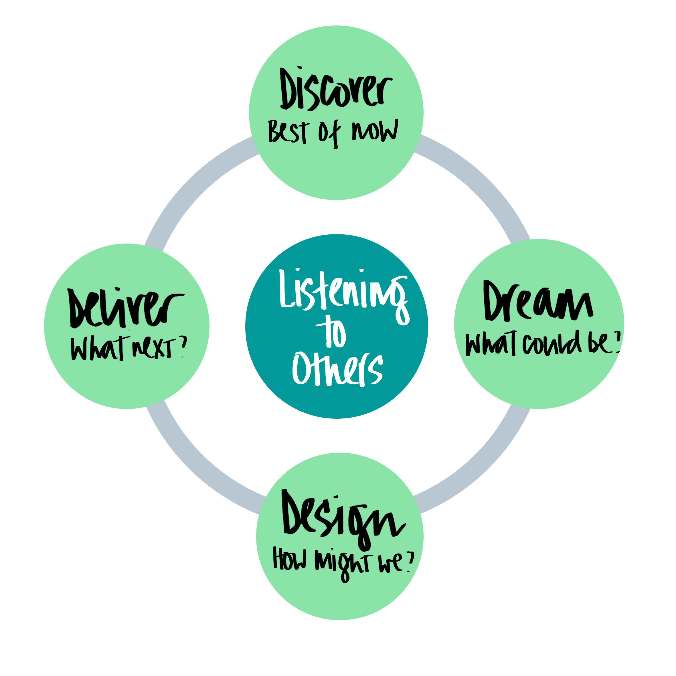
When you think about our teams’ assessment what’s working and what’s stuck?
What do we want to build on?
One small change you can make?
One small change your LM could make?
What if the team was flying, what would the impact be on us and the people we serve?
Ideas for change-shifting what’s stuck,
building on strengths
Easy-Win
Rolls-Royce
Mad Hatter

